Slide 1
StyTr2:Image Style Transfer with Transformers
(CVPR 2022)
Hakjun Moon
gloriel621@g.skku.edu
TNT Vision
2024/05/07

Slide 2
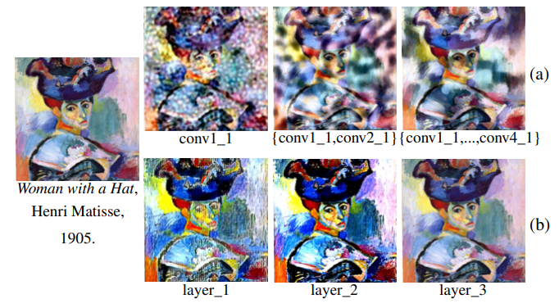
Introduction
(a): CNN Decoder Feature Visualization -> feature and fine detail loss
(b): Transformer Decoder with Feature Visualization

Slide 3
Two differences from NLP Transformer
Sequence token of image is related to Contents Information.
Uses CAPE, which is robust against semantic features and dynamic resolution of the image.

Slide 4
Main Contributions
A transformer-based style transfer framework called StyTr2
A content-aware positional encoding scheme (CAPE)
Good experiment results

Slide 5
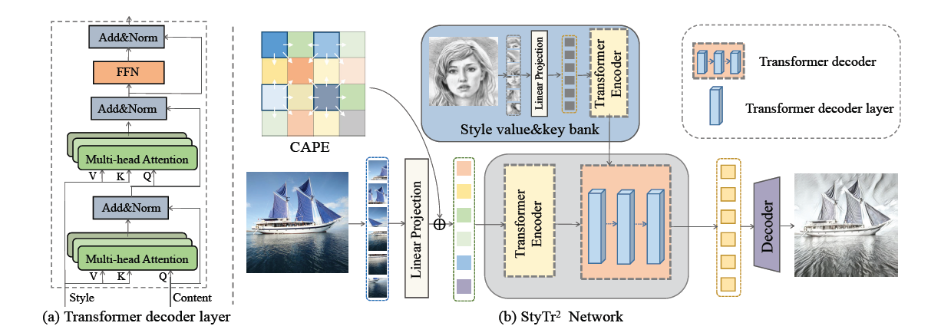
Overall Architecture

Slide 6
Overall Architecture
ViT
ViT
Transformer Decoder
CNN Decoder (VGG)

Slide 7
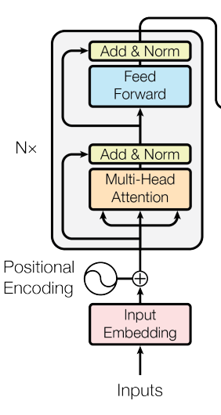
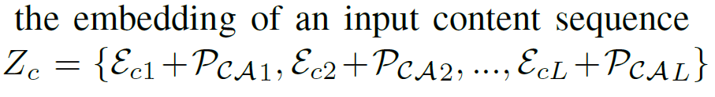
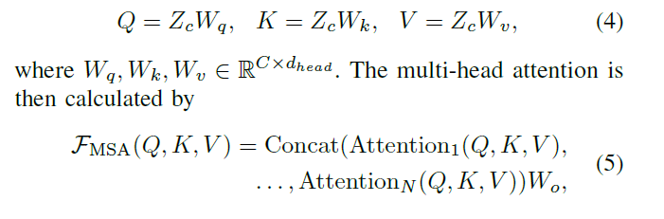
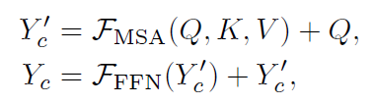
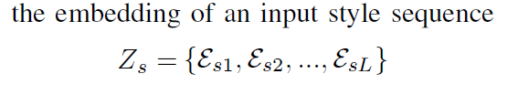
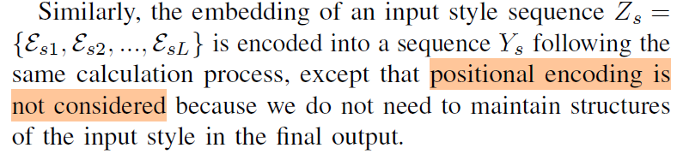
Style Transfer Transformer Encoder
1.
[Add and Norm + Feed Forward]
(MSA = Multi Head Self Attention)
2.

Slide 8
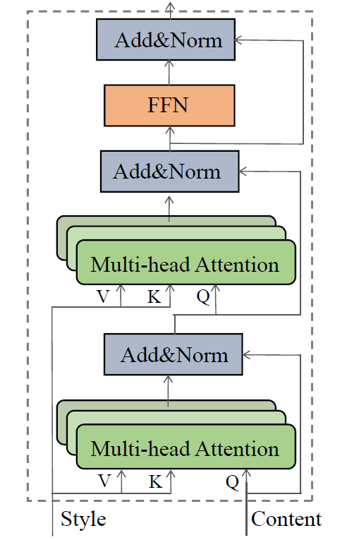
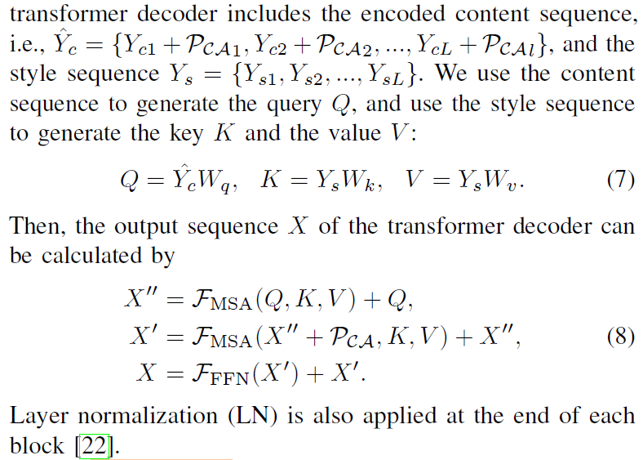
Style Transfer Transformer (Decoder)
content sequence = Query
style sequence = Key, Value

Slide 9
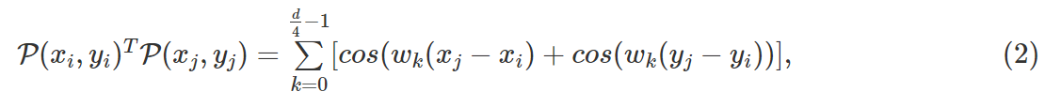
CAPE: Content-Aware Positional Encoding
[Traditional Positional Encoding using Transformer]
1. Attention Score for ith, jth patch
2. The relationship between pixel ($x_{i},y_{i}$) and ($x_{j},y_{j}$)

Slide 10
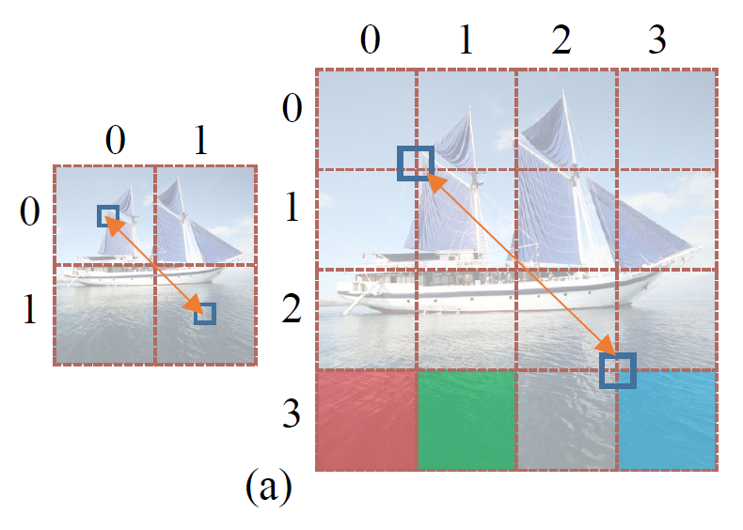
CAPE: Content-Aware Positional Encoding
[Problems of Traditional Method]
Distance of red and cyan patch > Distance of red and green patch
(in terms of embedding vectors)
2. The positional Encoding using sin and cos does not fit well
If the size of the input image changes.

Slide 11
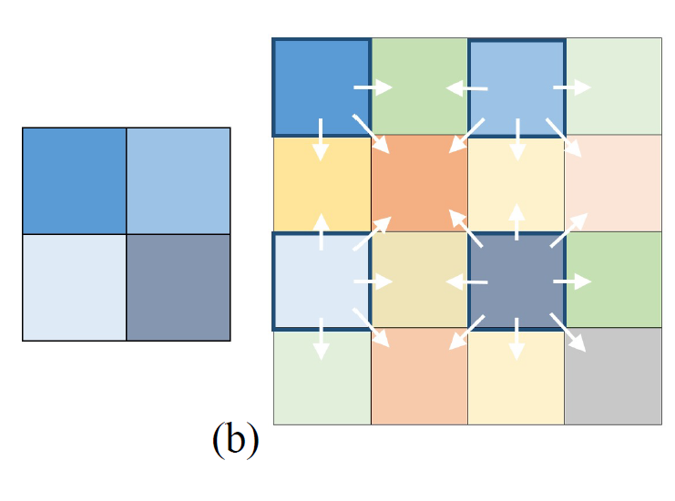
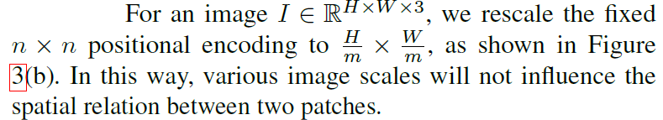
CAPE: Content-Aware Positional Encoding

Slide 12
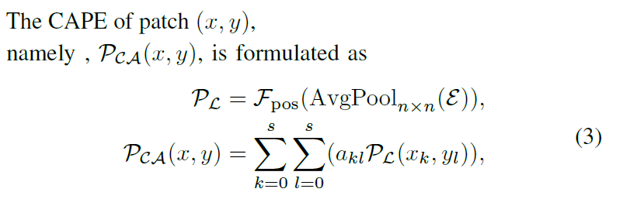
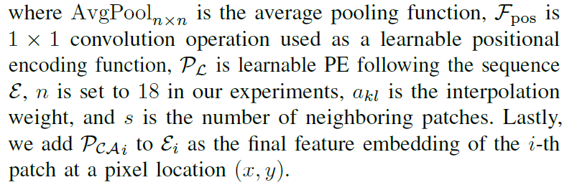

CAPE: Content-Aware Positional Encoding
[𝑛×𝑛 CAPE for RGB image]
$P_{L}$ = Positional encoding for ε

Slide 13
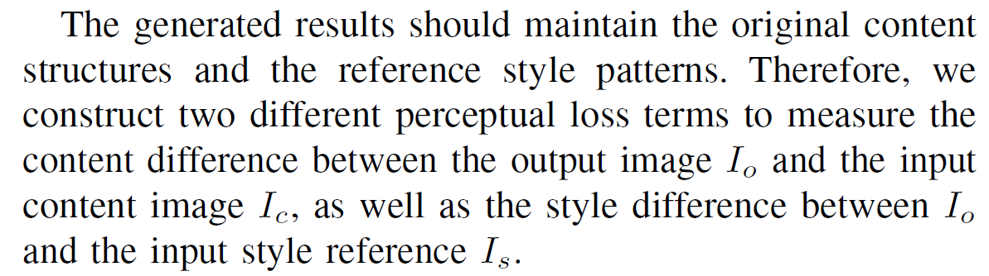
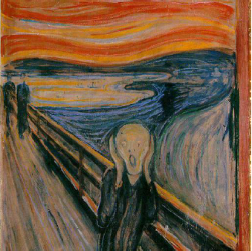
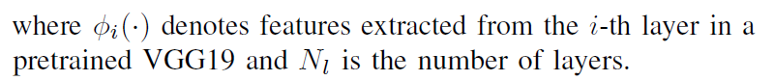
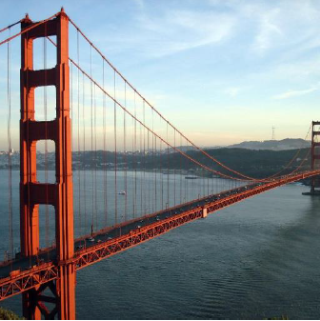
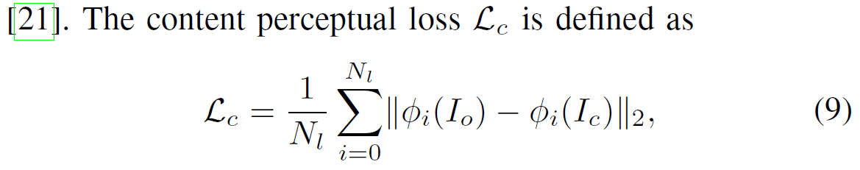

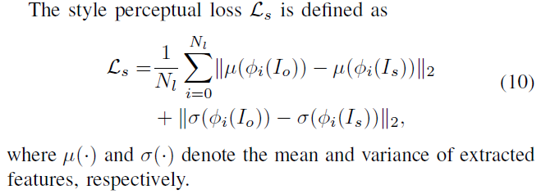
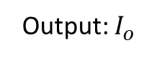
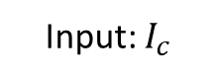
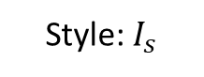
Loss Functions
Style: $I_{s}$
Input: $I_{c}$
Output: $I_{o}$

Slide 14
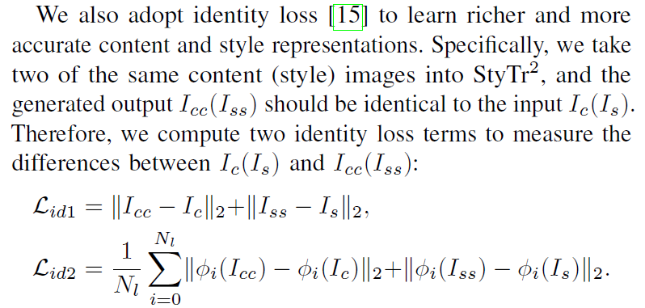
Loss Functions

Slide 15
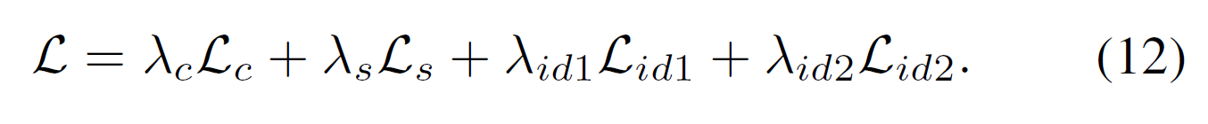
Loss Functions

Slide 16
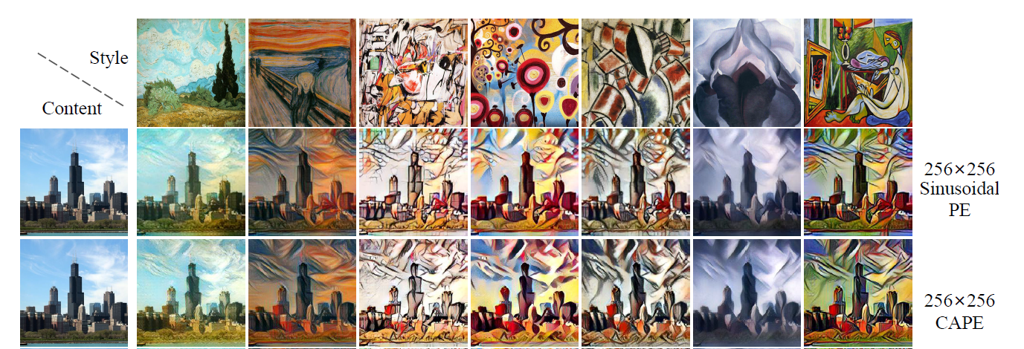
Experiment Results

Slide 17
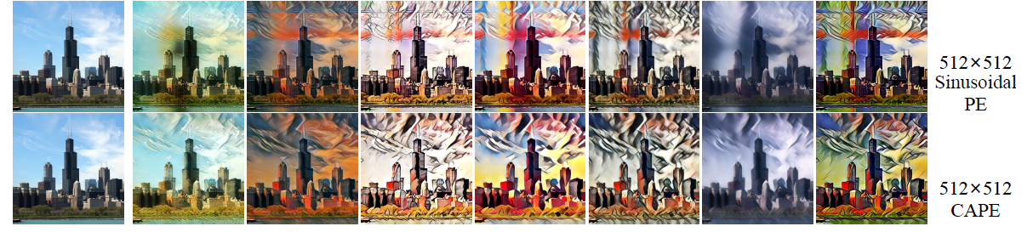
Experiment Results

Slide 18
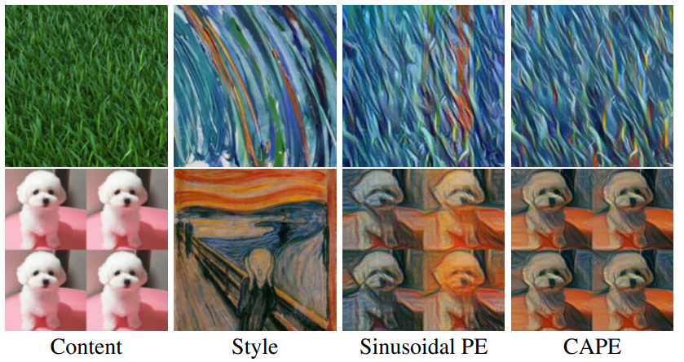
Experiment Results

Slide 19
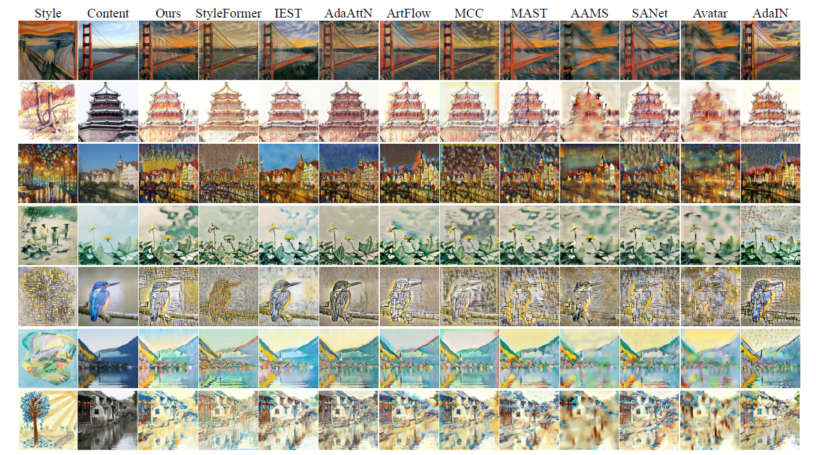
Experiment Results

Slide 20
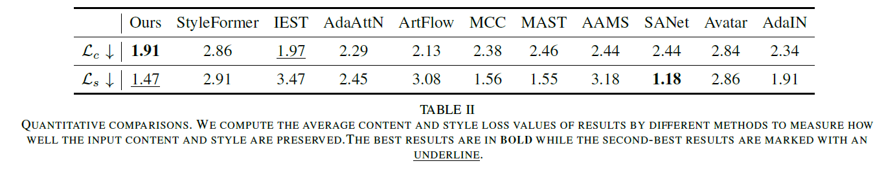
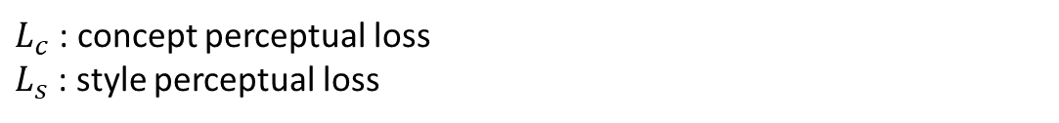
Experiment Results
$L_{c}$: concept perceptual loss
$L_{s}$: style perceptual loss

Slide 21
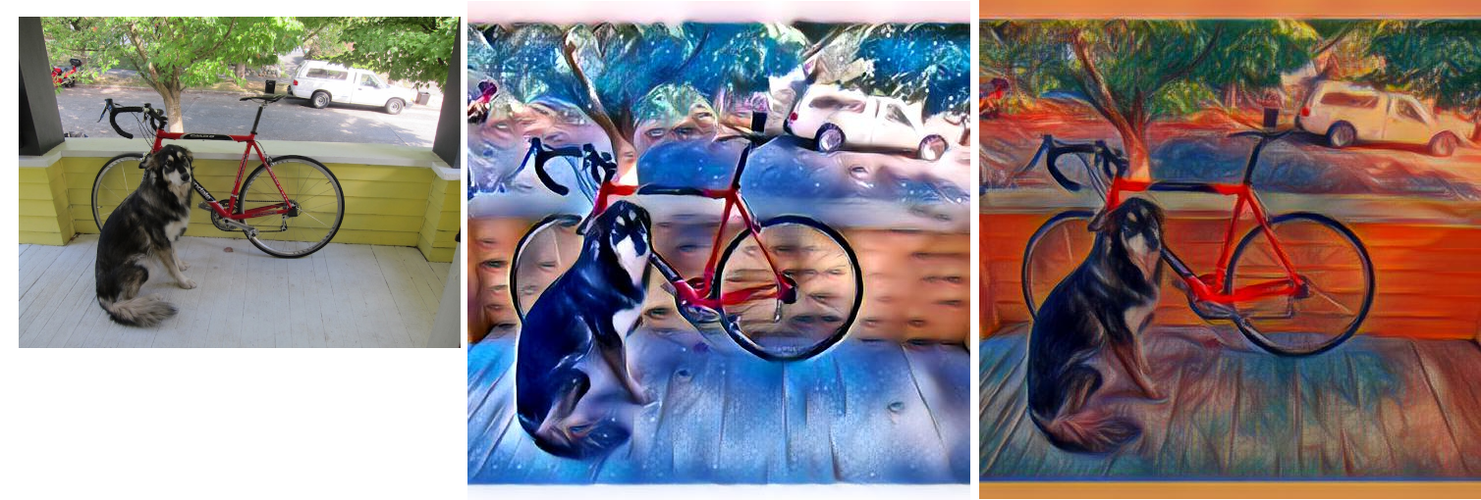

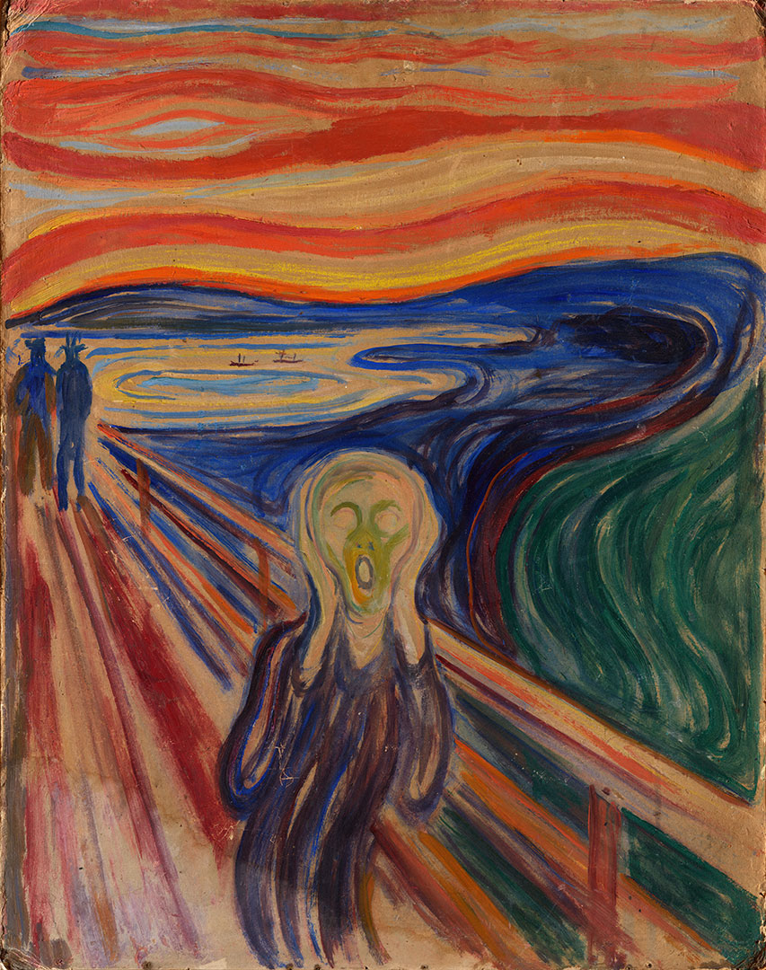
Inference Example
Input/Output
Style

Slide 22


